Slide 1
GIT & GITHUB Training

Slide 2


Training Objective
By the end of this training, participants will be able to:
Understand Git and GitHub fundamentals
• Use GitHub for version control and collaboration
• Manage repositories, branches, and commits
• Apply basic GitHub workflow in daily work

Slide 3
What is Git ?

Slide 4

What is a Git ?
› Git is a distributed version control system that lets developers track changes, collaborate on code, and manage revisions over time.
"Distributed" means no central server exists. Full project history is available locally after cloning
What is Github ?
› GitHub is a website builds on top of Git by adding collaboration tools, automation features, and a user-friendly web interface.

Slide 5




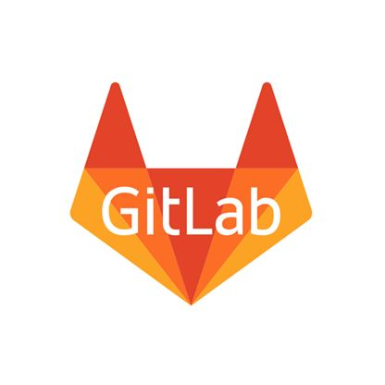




Git famous platforms

Slide 6
What is a Version Control System ?
› A system that records changes to a set of files over time. Essential for a development project with several people
Why we need it ?
› Keep every version of a file (source code, image ...)
› Work easily with several developers
› Compare changes Revert files back to a previous state...

Slide 7

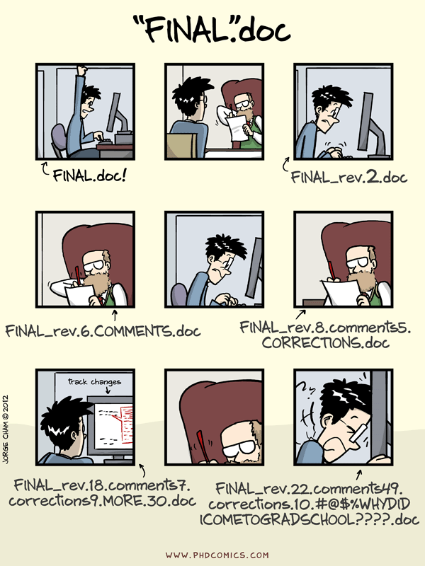


Slide 8
Why git ?
› Git manages changes to a tree of files over time
› Git is optimised for:
Distributed development
Large file count
Complex merges
Making trial branches
Being fast & robust
› Git is not optimised for:
File permissions/ ownership
unrelated individual files

Slide 9
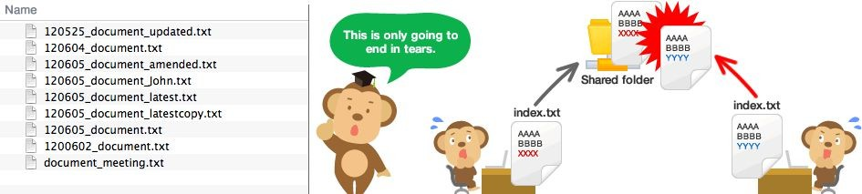
Why git is necessary to learn ?
› All IT dev companies uses VCS
› You will probably work in/start one
› No more problems like these:

Slide 10
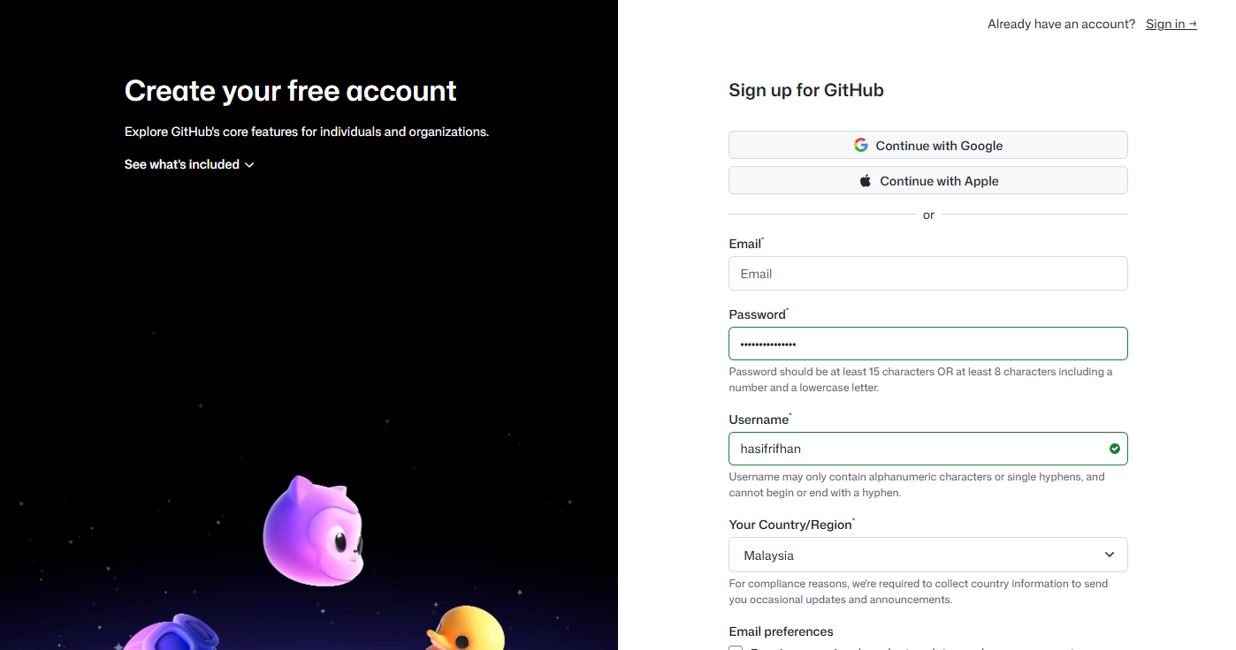
Github setup https://github.com/signup

Slide 11
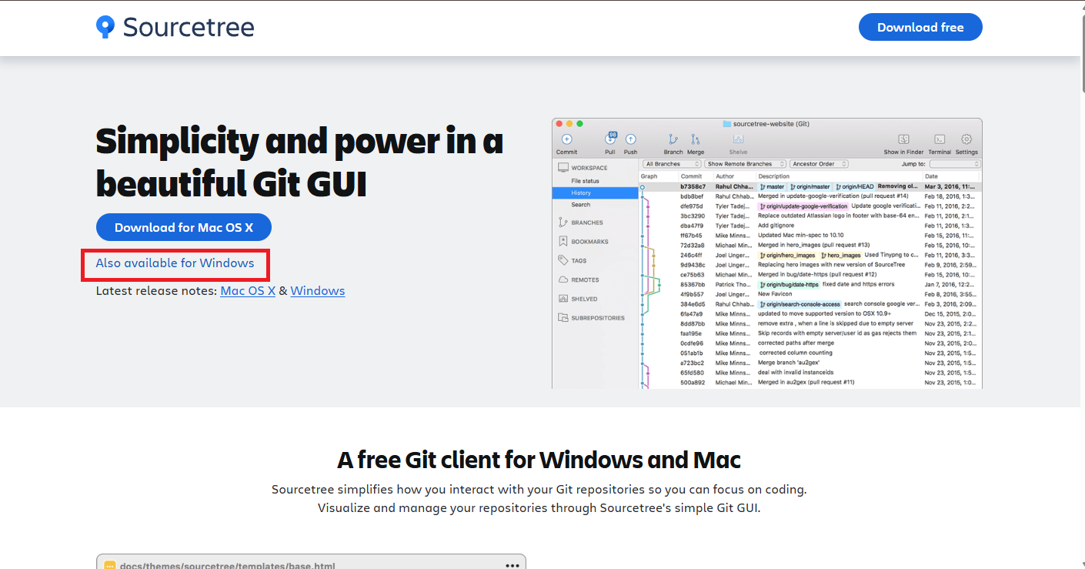
Sourcetree setup https://www.sourcetreeapp.com/

Slide 12
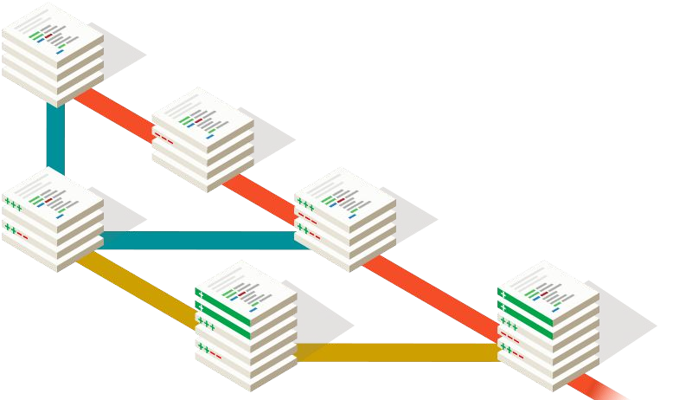
Git basics

Slide 13
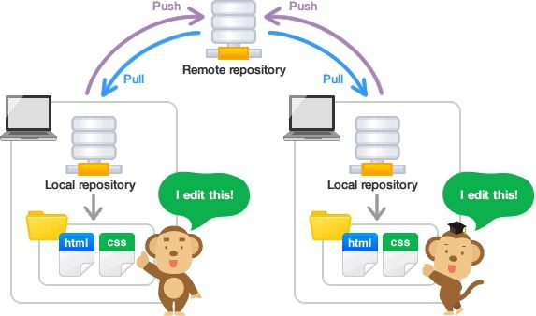
1. Repository
› Contains a collection of files and directories
› Records their change history and tracks their status and versions
There are two types:
› Remote Repository :
resides on a remote server that is shared among multiple team members.
› Local Repository :
resides on a local machine of an individual user.
git init [project-name]
# Create a new repository
git clone [url]
# Copy existing from URL

Slide 14
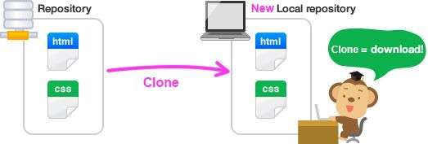
2. Clone
› If a remote repo already exists, you can fetch a copy from your local machine and start working on it
git clone [url]
# Copy a remote repo.

Slide 15
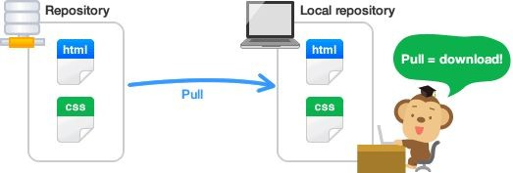
3. Pull
› Pull operation changes from the remote repo onto your local repo
› Unlike Clone, Pull downloads the latest revision history from a predefined remote
git pull [remote]
# Pull changes from a remote repo.

Slide 16
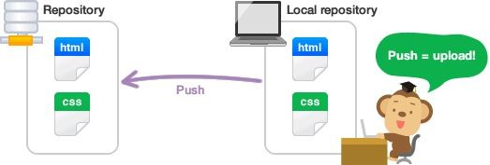
4. Push
› An operation that enables you to share your changes
› It simply moves the staged changes from the local repo to the remote repo
git push [remote] [branch]
# push staged changes to a remote repo (alias) in the specified (branch)

Slide 17
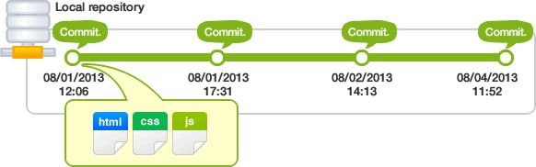
5. Commit
› An operation to record changes
› Enables you to consult previously committed changes
› Order your workflow & Identify each patch(update)
git commit -m ‘[message]’
# Create a commit with a description
git diff
# Shows file differences not yet staged
git status
# Lists new/modified files to be committed

Slide 18
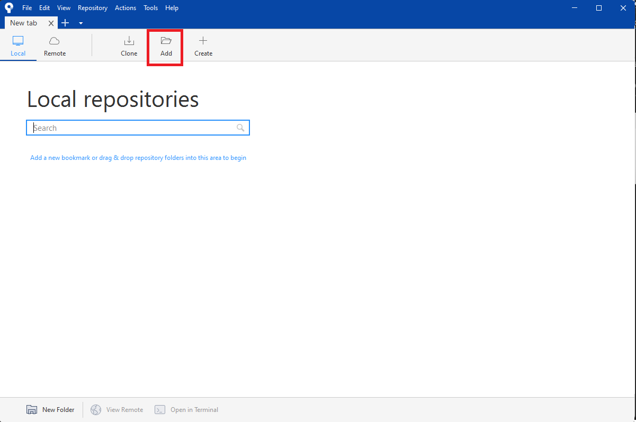
Repository setup and clone

Slide 19
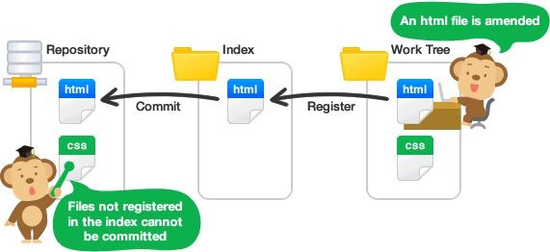
6. Working Tree and Index
› working tree: consist of files that you are currently working on.
› index: is a staging area where new commits are prepared. It is an interface between a repository and a working tree.
git add [ . | file.name | /directory]
# Add changement from work tree to index

Slide 20
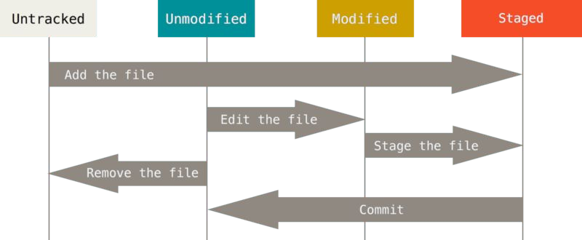
Note!
Changes made on the working tree will not be commited directly to the repository.
They need to be staged on the index first.

Slide 21
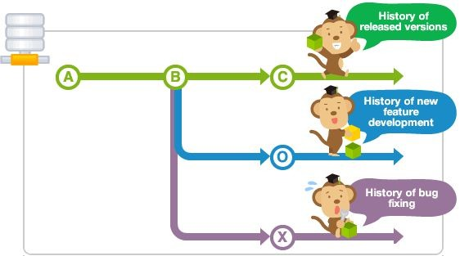
7. Branch
› An independent line of development
› Perfect for working on new features or bug fixes
› Each repository has main branch by default
git branch
# List available branches
git branch [branch-name]
# Add new branch
git checkout [branch-name]
# Switch to specified branch

Slide 22
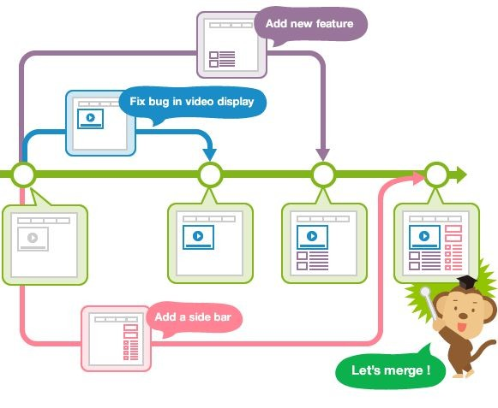
8. Merge
› An operation that applies the changes of a branch onto the Main branch
git merge [branch]
# Merge the specified branch

Slide 23
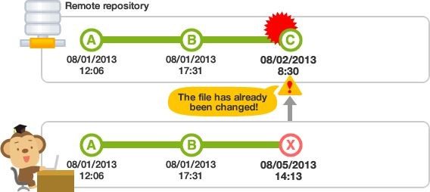
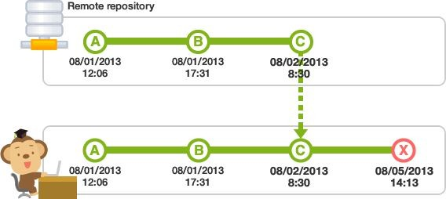
Your push to the remote repository will be rejected if your local repository is out of date, possibly because there are some updates that are on the remote repository added by others that you do not have locally yet.
This is called a Conflict
If that is the case, do a "pull" to grab the latest change from the remote repository before you are allowed to push.

Slide 24
THE END!
Any questions?

